Slide 1
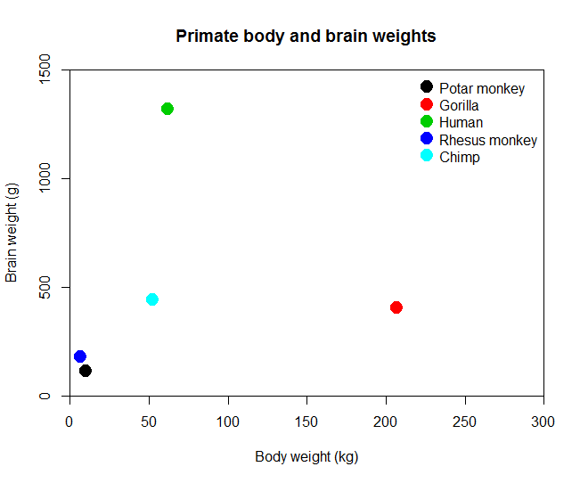
Hands-on exercise 1
You need: primates.csv
Try to replicate as closely as possible this graph
Colors are 1:5
Note the axes
Figure out how to add a title

Slide 2
Hands-on exercise 2
Create a 2×2 matrix Amat and a 2×3 matrix Bmat, each filled with unique numbers
Combine A and B into a 2×5 matrix Cmat and a 5×2 matrix Dmat
Create a factor Xfactor from the following vector such that 1 is female and 2 is male
sex <- c(1,1,2,1,2,2,2,1,1,1)
Create a list called data that contains matrices Amat, Bmat and Xfactor
Extract the first row of the matrix Amat from the list data
Change to NA the value in row 1 and column 1 of matrix Bmat within data.

Slide 3
Lecture 5 Data manipulation I
Kristin Privitera-Johnson
FISH 552 Introduction to R

Slide 4
Recommended reading
Data manipulation in R (Phil Spector, 2008)
http://www.springerlink.com/content/t19776/
Free download
Chapters 1, 5, 8

Slide 5
Outline for next three lectures
Lecture 5: splitting data, applying functions across data sets, ordering data
Lecture 6: merging data, dates, text manipulation, libraries in R
Lecture 7: practical example

Slide 6
Quick review of data manipulation
Many functions we have already seen in the class are useful tools in data manipulation
Using logical vectors to subset data is often the quickest and easiest way to manipulate data: &, |, !, ==, !=
Testing logical vector is also useful: any(), all(), which(), which.max()
What kind of data: is.array(), is.data.frame(), is.numeric()
How to handle missing data (NAs): is.na(), na.rm=

Slide 7
Testing logicals
nums <- c(12,9,8,14,7,16,3,2,9)
Are any numbers greater than 10?
> any(nums > 10)
[1] TRUE
Are all the numbers greater than 10?
> all(nums > 10)
[1] FALSE
Which numbers are greater than 10?
> which(nums > 10)
[1] 1 4 6
These are equivalent statements
> nums[which(nums > 10)]
[1] 12 14 16
> nums[nums > 10]
[1] 12 14 16

Slide 8
Unique and duplicate observations
A list of the unique observations in a vector
> plates <- c("WA","WA","OR","RI","WA","WA","CA",
"WA","WA")
> unique(plates)
[1] "WA" "OR" "RI" "CA"
Which elements in a vector are duplicated
> duplicated(plates)
[1] FALSE TRUE FALSE FALSE TRUE TRUE FALSE TRUE TRUE

Slide 9
Testing modes
You should always check that the data you are working with is behaving in the way you expect
> y <- rnorm(6)
> x <- sample(factor(1:6))
> (xy <- data.frame(x,y))
x y
1 1 -0.39264361
2 2 1.05148538
3 3 -0.04623392
4 3 0.04002289
5 2 -0.32184645
6 1 0.41500848
randomly sample from normal distribution
sample with replacement from the vector
create a data frame of the two
Not at all obvious whether x is correctly coded as a factor

Slide 10
Testing attributes
What kind of an object is x?
> is.numeric(xy$x)
[1] FALSE
> is.factor(xy$x)
[1] TRUE
What are its attributes?
> attributes(xy$x)
$levels
[1] "1" "2" "3"
$class
[1] "factor"

Slide 11
Creating new factors
Some data that are inherently continuous may need to be grouped categorically as a factor
The cut() function is an elegant way to do this
> ages <- c(47,14,24,33,74)
> cut(ages, breaks=c(0,18,65,Inf),
labels=c("Kid","Adult","Senior"))
[1] Adult Kid Adult Adult Senior
Levels: Kid Adult Senior
> nums3 <- 1:100
> cut(nums3, breaks=3)
[1] (0.901,34] (0.901,34] (0.901,34] (0.901,34]
...
Levels: (0.901,34] (34,67] (67,100]
Built-in constant “Infinity”

Slide 12
Useful built-in constants (??constants)
> pi
[1] 3.141593
> letters
[1] "a" "b" "c" "d" "e" "f" "g" "h" "i" "j" "k" "l" "m" "n" "o" "p" "q" "r" "s" "t" "u" "v" "w" "x" "y" "z"
> LETTERS
[1] "A" "B" "C" "D" "E" "F" "G" "H" "I" "J" "K" "L" "M" "N" "O" "P" "Q" "R" "S" "T" "U" "V" "W" "X" "Y" "Z"
> month.abb
[1] "Jan" "Feb" "Mar" "Apr" "May" "Jun" "Jul" "Aug" "Sep" "Oct" "Nov" "Dec"
> month.name
[1] "January" "February" "March" "April" "May" "June" "July" "August" "September" "October" "November" "December"

Slide 13
Built-in undefined characters
Inf: positive infinity, e.g. 1/0
-Inf: negative infinity
NaN: not a number, e.g. sqrt(-1)
NA: the number is unknown, garbled, undefined
NULL: completely blank, nothing there
> x <- NA
> (x <- c(x,1,2,3))
[1] NA 1 2 3
> x <- NULL
> (x <- c(x,1,2,3))
[1] 1 2 3

Slide 14
Subsetting data
We know how to subset a data frame or matrix, but when NAs are involved things may go awry
> x <- data.frame(a=c(11,13,12,15,17,20),
b=c( 8,NA, 6, 4,NA,15))
> x[x$b>5,]
a b
1 11 8
NA NA NA
3 12 6
NA.1 NA NA
6 20 15

Slide 15
The subset() function
Elegantly extracts portions of a data frame or matrix while handling NA values appropriately
subset(object, logical expression, variable selection)
> x <- data.frame(a=c(11,13,12,15,17,20),
b=c( 8,NA, 6, 4,NA,15))
> subset(x=x, subset=b>5)
a b
1 11 8
3 12 6
6 20 15
> subset(x=x, subset=b>7, select=a)
a
1 11
6 20

